Slide 1

ExperiențA POLONIEI
În domeniul RED
Masa Rotundă
RED în Moldova: Aici și Acum
26 aprilie 2016

Slide 2
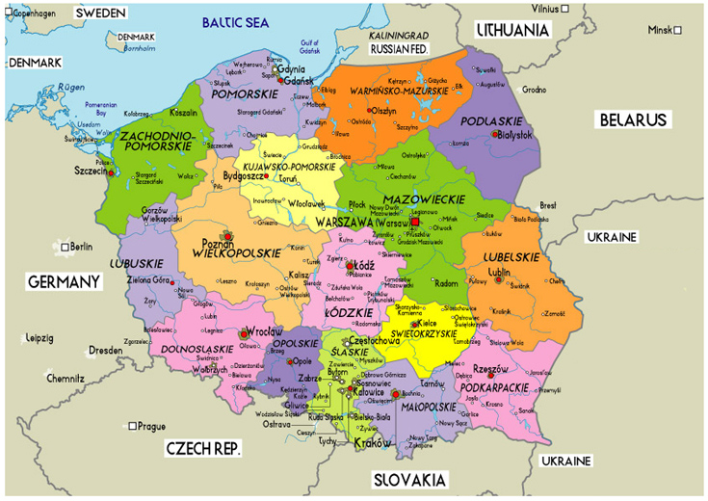

General Information
Capital: Warsaw
Area: 312,679 km²
Population: 38,500,000
Schools: 63000
Universities: > 50

Slide 3
ICT as a subject
Students begin taking technology-related courses during primary school when the child is approximately 12 years of age. At the grammar school level students are exposed to 2 hours a week of obligatory subject "computer science", which is called "informatyka".
The curricula of this subject includes the following:
Computes in everyday life.
Working with computers.
Utility software (graphics editors, text editors, spreadsheets, databases).
Multimedia sources of information.
Algorithms.
Simulation and modelling.
Students continue the ICT focus while in vocational, technical secondary, specialized lyceum, and general lyceum schools. In general, the use of technology is being more widely incorporated into the curriculum as head teachers are encouraging teachers to include ICT in the classroom.

Slide 4
The use of computers in schools
Poland supports the European Union’s vision for ICT in education policy. Consequently, eEurope and eEurope+ action plans were followed. However, ICT in Polish education is not as widespread and modern as it is in other prominant EU countries.
The main aims and priorities of the policy were and still are:
Introduce the ICT in education to all schools - not only through lessons in computer science but also through lessons in other school subjects,
Prepare all teachers to become animators of ICT in their schools and to use ICT for pedagogical purposes,
Assure access to rich educational content for all students.
Efforts were made to turn school libraries into multimedia information centres.
Computers in Polish schools are mostly purchased by the Ministry of National Education and local governments.

Slide 5
Educational Portals
Portal Scholaris (www.scholaris.pl)
Internet Centre of Educational Resourses of Ministry of Education – (launched with the support from European Union) - is the biggest and the most famous one.
It contains a large number of e-lessons, presentations, simulations, tests, pictures, maps, movies etc. categorized in two ways: type of material and subject that it is useful for. Also the portal contains online journals for teachers. Many of these journals are focused on using ICT in education (for example: New Technologies in the School, Safe Internet, Interklasa).
Eduseek - The largest educational portal, divided into three parts: for students, parents and teachers. Training contents are arranged according to school subjects. It includes, among others, catalog of educational sites, forums, legal advice, information about courses and training, a lot of teaching aids.
Interklasa - Portal contains a constantly updated catalog of Polish educational resources on the network, websites of all schools participating in the program Interkl@sa mailboxes students and teachers.
Full list of Polish Educational Portals

Slide 6
Development of OER in POLAND Top-Down Initiatives
Ministry of National Education – Project “Involve Poland!”, 2009 (scholaris.pl)
  ﻿first MNE-funded service offering open education resources
  restrictions for publishing OER
Ministry of National Education – Programme “Digital School”, 2013
  set of open e-textbooks
  change of approach to open resources at the MNE

Slide 7
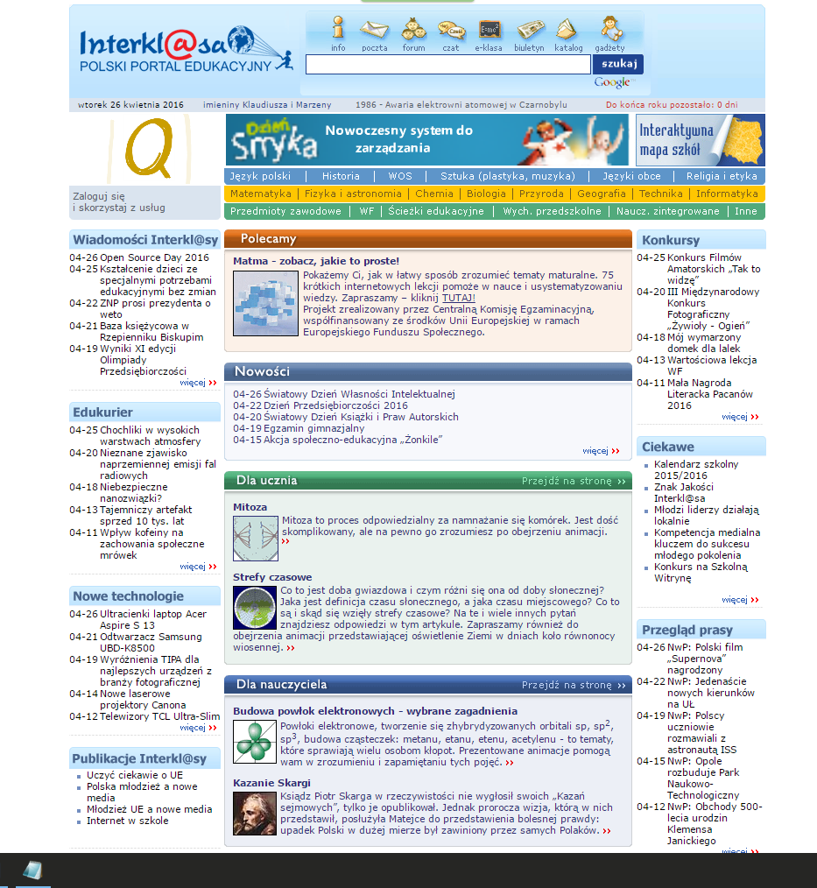
Development of OER in POLAND Grassroots Initiatives
﻿Since 2004 educational projects promoting openness were mainly carried out by nongovernmental organizations as a response to governmental initiatives.
A pioneering initiative aimed at development of educational resources for students, teachers and parents was undertaken by the nongovernmental programme “Interkl@sa”. It was launched in 1998 as a national programme for information society, whose objective was providing schools with the necessary infrastructure.
The year 2010 was the time of breakthrough in making the website resources open. Due to the emergence of Fundacja Polskiego Portalu Edukacyjnego Interkl@sa, the website is constantly updated.

Slide 8
Development of OER in POLAND Grassroots Initiatives 2
﻿﻿In 2005, the Polish section of Creative Commons was established, joining the international Creative
Commons community, which has branches and sections in about 70 countries. At the moment,
the Centrum Cyfrowe Projekt: Polska and Interdisciplinary Centre for Mathematical and Computational
Modelling (ICM UW) are its institutional partners. Thanks to the active involvement of CC Polska and to
its cooperation with lawyers, Creative Commons licenses have been translated into Polish and analysed
with respect to their compatibility with the Polish legislation. Creative Commons has also prepared the
first handbooks about the licenses and their possible applications, and has offered support to people
and organisations willing to implement the policy of openness. Since its inception CC Polska is very
active in the legal field (the porting of licenses, preparing analyses about the compatibility with the
Polish legislation, advising on the application of licenses) and in the area of education (training sessions,
cooperation with institutions that use CC in their activities, for example the Orange Foundation, the
National Art Gallery Zachęta, and the Ministry of Foreign Affairs).

Slide 9
Development of OER in POLAND Grassroots Initiatives 3
﻿The Wikimedia Polska Association is one of the most active among nongovernmental organisations.
Since 2005 it has been promoting and supporting the projects by the Wikimedia Foundation developed on Polish grounds.
The most popular project is the Wikipedia Free Encyclopedia, which is being developed by its users. Wikipedia emerged at the beginning of 2001. Polish Wikipedia has almost 1 million entries, created and developed by over half a million users, and their number is constantly growing. Wikimedia Commons, second in size foundation project, was initially created as a repository for multimedia files for various Wikipedia language versions. Presently it is the largest collection of pictures, graphics, models, movies and music on the Internet, all of them being available under free licenses.

Slide 10
Development of OER in POLAND Grassroots Initiatives 4
﻿﻿Among other projects worth mentioning are the activities of the wiki community in the area of creating books and textbooks, known as WikiBooks — library of free textbooks. The Polish version has 6000 pages of texts. A project derived from this initiative is a library of books and textbooks created for children: Wikijunior. The Wikimedia Polska association also runs projects for the development of a community gathered around open resources and related activities. Since 2006 they organize a yearly conference, Wikimedia Polska, which aims at the exchange of experience among users who participate in developing Wikimedia projects and deal with open software and free access to knowledge.
Wikiekspedycja exists since 2009, and its objective is to photograph various places in Poland and around the world to illustrate Wikipedia entries. In 2011, the Association launched a competition “Wiki likes monuments” (Wiki Lubi Zabytki) and organised a mobile gallery of the photos — winners of the Polish competition.

Slide 11
Development of OER in POLAND Grassroots Initiatives 5
﻿﻿In 2004, the Modern Poland Foundation (Fundacja Nowoczesna Polska) established Free Readings Internet Library (Biblioteka Internetowa Wolne Lektury).
Among its resources there are almost 2000 works by 120 authors, which are daily accessed by up to 9000 users. The Library includes educational materials recommended by the Ministry of National Education, which can be used without paying fees or setting up an account. The foundation focuses mainly on editing texts that moved into the public domain.
Since 2002 the foundation has been obtaining rights to protected works, including, for instance, those by Maria Dąbrowska or Miłosz Biedrzycki, which are shared under the free license CC BY-SA. All texts are properly edited: they contain footnotes, literary motifs and are available in HTML, TXT, PDF, EPUB, MOBI, and FB2 formats.
There are also a few hundred audiobooks (available in several formats, for users who have reading difficulties)..

Slide 12
Polish Coalition for Open Education
﻿The emergence, at the end of 2008, of the Coalition for Open Education (KOED) was the consolidating event for projects advocating openness implemented at the time.
The Coalition for Open Education was created through the initiative of four institutions:
Modern Poland Foundation (Fundacja Nowoczesna Polska),
Wikimedia Poland Association (Stowarzyszenie Wikimedia Polska),
Polish Librarians’ Association (Stowarzyszenia Bibliotekarzy Polskich),
Interdisciplinary Centre for Mathematical and Computational Modelling (Interdyscyplinarne Centrum Modelowania Matematycznego i Komputerowego Uniwersytetu Warszawskiego).
Since 2009 the Coalition has been funded by the Open Society Foundation, which enables it to be actively engaged in shaping of openness policies in Poland.

Slide 13
Polish Coalition for Open Education
﻿﻿To make the process of education easier, the KOED designed a pyramid illustrating the openness of resources in a legal context.

Slide 14
Development of OER in POLAND Grassroots Initiatives 6
Centrum Cyfrowe Projekt Polska works towards social change and enhancing citizens’ participation through the use of digital technologies and open, cooperative models based on sharing knowledge and other resources. Its projects fall into three main categories: Open Government, Open NGO, Open Culture.
AGH University of Science and Technology is a high-rank university in modern technologies. In 2010, AGH launched “Open AGH” initiative — the first Polish repository of open learning resources for STEM at academic level. Since 2013 AGH has been working on development of open e-textbooks for science, technology, engineering and mathematics subjects in line with the National Qualifications Framework.

Slide 15

World Directory of OER repositories
Directory of OER repositories

Slide 16
Thank YOU For Attention!
Arcadi Malearovici
amalearovici@gmail.com

